Slide 1
Big Mountain Ski Resort
Data analysis and recommendations for 2020-2021 ski season

Slide 2
Problem statement
A new chair lift was recently added to increase distribution of visitors across the resort. The additional chair increases yearly operating costs by $1.54 million. Using the current data, the goal is to best determine the following:
How to better leverage and market their equipment, facilities and location, and…
Maintain their current profit margin of 9.2% and…
Recover their investment cost of $1.54 million dollars over the next ski season

Slide 3
Key Findings and Recommendations
The current adult weekend ticket price (of $81) is below the competitive price for comparable ski resorts across the United States.
Considering a number of ski resort features (such as number of chairs, the speed and size of the chairs, total skiable terrain, days open in the previous season and more) we recommend that the adult weekend ticket price be increased to $89

Slide 4
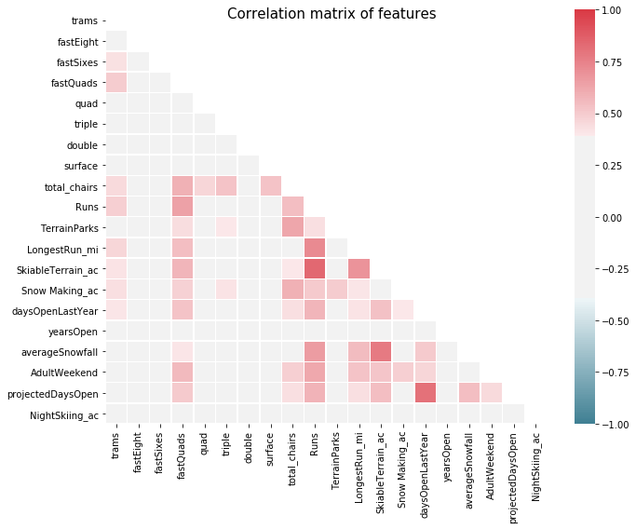
Model Results and Analysis (1)
20 features were included in the model (as seen in the heatmap on the right)
More features were included initially but were dropped as they were outside of the resort’s control (summit elevation, location, total vertical drop, and more)
Heatmap shows correlated and potential co-linear features

Slide 5
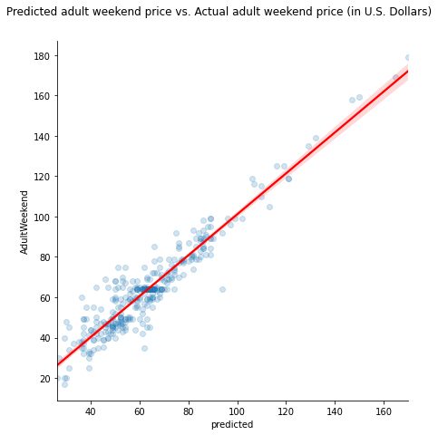
Model Results and Analysis (2)
The relationship between the predicted values from the model and the actual values from the data fit to an acceptable degree (R-Squared = .889)
Model does seem to predict price upwards

Slide 6
Model Results and Analysis (3)
Model Performance Metrics:
Mean Absolute Error (MAE), % | 5.29505057
Mean Squared Error (MSE) | 51.56212765
Root Mean Squared Error (RMSE) | 7.18067738
R-Squared Value | 0.889
The model performed well and gives us a good idea of how best to increase prices to achieve the goals stated in the first slide.

Slide 7
Summary and Conclusions
In order to help management at the Big Mountain ski resort recover investment and operating costs from a new chair, a linear regression model was created using 20 unique features to predict a new adult weekend ticket price.
The model performed well and produced the recommended ticket price of $89 (up $9 from the current ticket price of $81)
Because no data was provided on visitation, the hard numbers for profits can’t be calculated. However, the numbers and analysis used in this model serve as a starting point and can be explored further by the marketing teams

